Slide 1




Web Automation in R
Automation
HA UG
2022

Slide 2

Github webpage
R analysis

Slide 3

LME + blocking
R analysis

Slide 4


Data Viz

Slide 6

NLP
Sentiment analysis
HARPE
DATA
SCIENCE

Slide 7
Sample size?
R simulation

Slide 8
NLP basics
HARPE
DATA
SCIENCE

Slide 9
T-test
R Bootcamp
2.5

Slide 10
Regression
R Bootcamp
2.4

Slide 11
Correlation
R Bootcamp
2.3

Slide 12
Distributions
R Bootcamp
2.2

Slide 13
summarizing
data
R Bootcamp
2.1
HARPE
DATA
SCIENCE

Slide 14
HAP-E
Machine learning
concept
HARPE
DATA
SCIENCE

Slide 15
HAP-E
Stats basics
HARPE
DATA
SCIENCE

Slide 16
HAP-E
Data wrangling
HARPE
DATA
SCIENCE

Slide 17
HAP-E
Python graphs
HARPE
DATA
SCIENCE

Slide 18

HAP-E
Python setup
HARPE
DATA
SCIENCE

Slide 19
manipulating
data
R Bootcamp
1.5
HARPE
DATA
SCIENCE

Slide 20
R Bootcamp
1.4
HARPE
DATA
SCIENCE

Slide 21
R Bootcamp
1.3
HARPE
DATA
SCIENCE

Slide 22

Github
Website
HARPE
HARPE
DATA
SCIENCE
SCIENCE

Slide 23


R Bootcamp
0.0 overview
HARPE
HARPE
DATA
SCIENCE
SCIENCE

Slide 24

R Bootcamp
0.1 RStudio
HARPE
HARPE
DATA
SCIENCE
SCIENCE

Slide 25
R Bootcamp
1.1 R Syntax
HARPE
HARPE
DATA
SCIENCE
SCIENCE

Slide 26
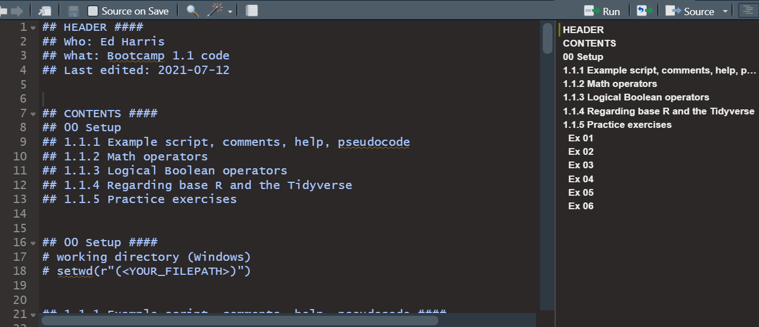
R Bootcamp
1.1 R Syntax
HARPE
HARPE
DATA
SCIENCE
SCIENCE

Slide 27
R Bootcamp
1.2 Functions
HARPE
HARPE
DATA
SCIENCE
SCIENCE

Slide 28
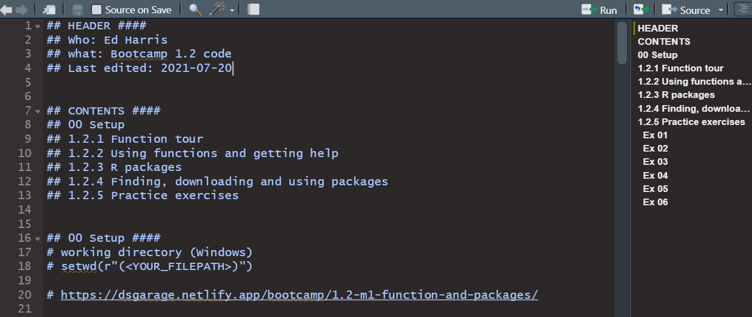
R Bootcamp
1.2 Functions
HARPE
HARPE
DATA
SCIENCE
SCIENCE

Slide 29


Q
C7081
2021
antine

Slide 30
Q
antine
Q
antine

Slide 31


HARPE
D
D
HARPE
HARPE
T
T
A
A
2021
HA UG!
D
HARPE
T
2021
A

Slide 32
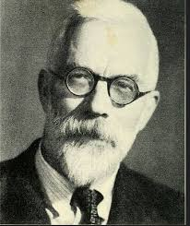
HARPE
HARPE
DATA
SCIENCE
HARPE
HARPE
DATA
SCIENCE

Slide 33


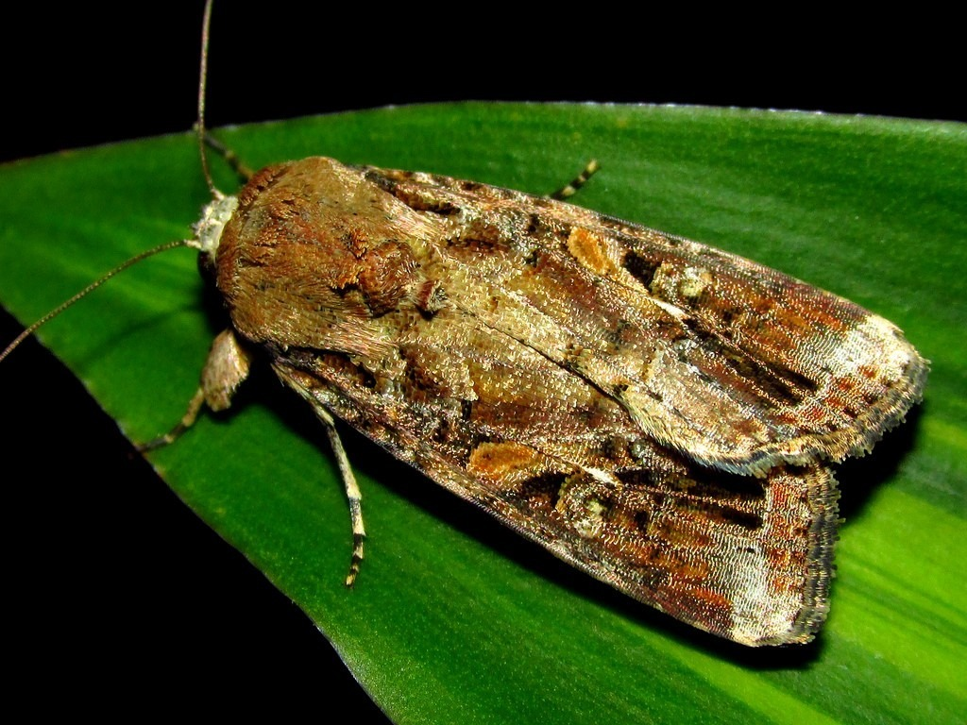






DS
EDA
2021
GA
AGE
DS
2021
DATA
SCIENCE
DS
GA
AGE

Slide 35

shinycustomloader
shinycustomloader
shinycustomloader
shinycustomloader
shinycustomloader
shinycustomloader
shinycustomloader
shinycustomloader
http://hexb.in/sticker.html

